Slide 1
Design Patterns
Unit 07
Factory Patterns:
Factory Method and Abstract Factory

Slide 2
Objectives
In this lesson, you will learn to:
● Factory
- Factory Method (Class creational pattern–inheritance)
- Abstract Factory (Object creational patterns–composition)

Slide 3
Factory Patterns
Factory patterns are examples of creational patterns
Creational patterns abstract the object instantiation process. They hide how objects are created and help make the overall system independent of how its objects are created and composed.
Class creational patterns use inheritance to decide the object to be instantiated
    Factory Method
Object creational patterns use composition to delegate (委托) the instantiation to another object
    Abstract Factory

Slide 4
Factory Patterns
All OO languages have an idiom (习语) for object creation. In Java this idiom is the new operator.
Creational patterns allow us to write methods that create new objects without explicitly using the new operator.
This allows us to write methods that can instantiate different objects and that can be extended to instantiate other newly-developed objects, all without modifying the method's code!

Slide 5
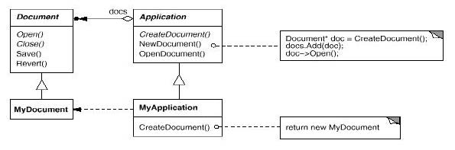
The Factory Method Pattern
Intent
  Define an interface for creating an object, but let subclasses decide which class to instantiate. Factory Method lets a class defer instantiation to subclasses.
Motivation
  Consider the following framework:
  The createDocument() method is a factory method.

Slide 6
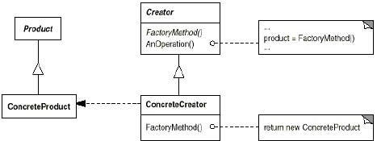
The Factory Method Pattern
Applicability (适用性)
Use the Factory Method pattern in any of the following situations:
  A class can’t anticipate (预见) the class of objects it must create
  A class wants its subclasses to specify the objects it creates
Structure

Slide 7
The Factory Method Pattern
Participants
  Product
    Defines the interface for the type of objects the factory method creates
  ConcreteProduct
    Implements the Product interface
  Creator
    Declares the factory method, which returns an object of type Product
  ConcreteCreator
    Overrides the factory method to return an instance of a ConcreteProduct
Collaborations
  Creator relies on its subclasses to implement the factory method so that it returns an instance of the appropriate ConcreteProduct

Slide 8
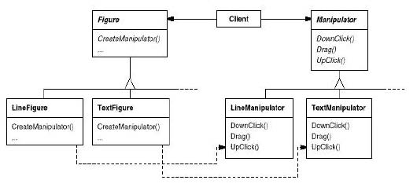
Factory Method Example 1
Clients can also use factory methods:
The factory method in this case is createManipulator()

Slide 9
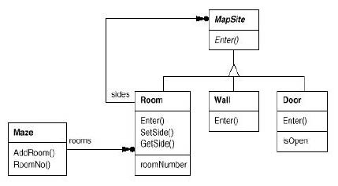
Factory Method Example 2
Consider this maze game:

Slide 10
Factory Method Example 2 (Contd.)
Here's a MazeGame class with a createMaze() method:
  /**
  * MazeGame.
  */
  public class MazeGame {
    // Create the maze.
    public Maze createMaze() {
      Maze maze = new Maze();
      Room r1 = new Room(1);
      Room r2 = new Room(2);
      Door door = new Door(r1, r2);
      maze.addRoom(r1);
      maze.addRoom(r2);

Slide 11
Factory Method Example 2 (Contd.)
    r1.setSide(MazeGame.North, new Wall());
    r1.setSide(MazeGame.East, door);
    r1.setSide(MazeGame.South, new Wall());
    r1.setSide(MazeGame.West, new Wall());
    r2.setSide(MazeGame.North, new Wall());
    r2.setSide(MazeGame.East, new Wall());
    r2.setSide(MazeGame.South, new Wall());
    r2.setSide(MazeGame.West, door);
    return maze;
  }
}

Slide 12
Factory Method Example 2 (Contd.)
The problem with this createMaze() method is its inflexibility.
What if we wanted to have enchanted (被施魔法的) mazes with EnchantedRooms and EnchantedDoors? Or a secret agent maze with DoorWithLock and
WallWithHiddenDoor?
What would we have to do with the createMaze() method? As it stands now, we would have to make significant changes to it because of the explicit instantiations using the new operator of the objects that make up the maze. How can we redesign things to make it easier for createMaze() to be able to create mazes with new types of objects?

Slide 13
Factory Method Example 2 (Contd.)
Let's add factory methods to the MazeGame class:
/**
* MazeGame with a factory methods.
*/
public class MazeGame {
  public Maze makeMaze()
  {return new Maze();}
  public Room makeRoom(int n)
  {return new Room(n);}
  public Wall makeWall()
  {return new Wall();}
  public Door makeDoor(Room r1, Room r2)
  {return new Door(r1, r2);}

Slide 14
Factory Method Example 2 (Contd.)
  public Maze createMaze() {
    Maze maze = makeMaze();
    Room r1 = makeRoom(1);
    Room r2 = makeRoom(2);
    Door door = makeDoor(r1, r2);
    maze.addRoom(r1);
    maze.addRoom(r2);
    r1.setSide(MazeGame.North, makeWall());
    r1.setSide(MazeGame.East, door);
    r1.setSide(MazeGame.South, makeWall());
    r1.setSide(MazeGame.West, makeWall());
    r2.setSide(MazeGame.North, makeWall());
    r2.setSide(MazeGame.East, makeWall());
    r2.setSide(MazeGame.South, makeWall());
    r2.setSide(MazeGame.West, door);
    return maze;
    }
  }

Slide 15
Factory Method Example 2 (Contd.)
We made createMaze consider this EnchantedMazeGame () just slightly more complex, but a lot more flexible!
class:
  public class EnchantedMazeGame extends MazeGame{
    public Room makeRoom(int n)
    {return new EnchantedRoom(n);}
    public Wall makeWall()
    {return new EnchantedWall();}
    public Door makeDoor(Room r1, Room r2)
    {return new EnchantedDoor(r1, r2);}
  }
The createMaze() method of MazeGame is inherited by EnchantedMazeGame and can be used to create regular mazes or enchanted mazes without modification!

Slide 16
Factory Method Example 2 (Contd.)
The reason this works is that the createMaze() method of MazeGame defers the creation of maze objects to its subclasses. That's the Factory Method pattern at work!
In this example, the correlations are:
  Creator => MazeGame (Concrete Class)
  ConcreteCreator => EnchantedMazeGame
  Product => MapSite
  ConcreteProduct => Wall, Room, Door, EnchantedWall, EnchantedRoom, EnchantedDoor

Slide 17
Factory Method Example 3
Java Collection framework
In this example, the correlations are:
  Creator => Collection (interface) –iterator () method
  ConcreteCreator =>LinkedList, HashSet,…
  Product => Iterator (interface)
  ConcreteProduct =>……

Slide 18
Factory Method Pattern
Consequences
  Benefits
    Code is made more flexible and reusable by the elimination of instantiation of application-specific classes
    Code deals only with the interface of the Product class and can work with any ConcreteProduct class that supports this interface
  Liabilities
    Clients might have to subclass the Creator class just to instantiate a particular ConcreteProduct
Implementation Issues
    Creator can be abstract or concrete
    Should the factory method be able to create multiple kinds of products? If so, then the factory method has a parameter (possibly used in an if-else!) to decide what object to create.
Notes:
可以在这里举个例子：SQL QUERY 的例子。

Slide 19
The Abstract Factory Pattern
Intent
  Provide an interface for creating families of related or dependent objects without specifying their concrete classes.
  The Abstract Factory pattern is very similar to the Factory Method pattern.
  One difference between the two is that with the Abstract Factory pattern, a class delegates the responsibility of object instantiation to another object via composition whereas the Factory Method pattern uses inheritance and relies on a subclass to handle the desired object instantiation.
  Actually, the delegated object frequently uses factory methods to perform the instantiation!

Slide 20
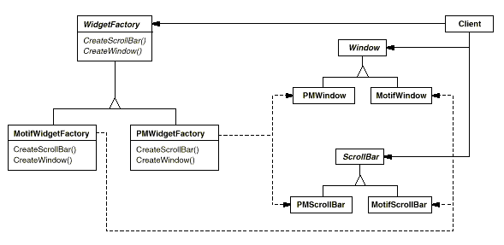
The Abstract Factory Pattern
Motivation
  A GUI toolkit that supports multiple look-and-feels:

Slide 21
The Abstract Factory Pattern
Applicability
Use the Abstract Factory pattern in any of the following situations:
  A system should be independent of how its products are created, composed, and represented
  A class can't anticipate the class of objects it must create
  A system must use just one of a set of families of products
  A family of related product objects is designed to be used together, and you need to enforce this constraint
  you want to provide a class library of products, and you want to reveal just their interfaces, not their implementations.

Slide 22
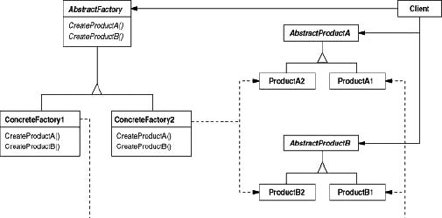
The Abstract Factory Pattern
Structure

Slide 23
The Abstract Factory Pattern
Participants
  AbstractFactory (WidgetFactory)
    Declares an interface for operations that create abstract product objects
  ConcreteFactory (MotifWidgetFactory, PMWidgetFactory)
    Implements the operations to create concrete product objects
  AbstractProduct (Window, ScrollBar)
    Declares an interface for a type of product object
  ConcreteProduct (MotifWindow, MotifScrollBar)
    Defines a product object to be created by the corresponding concrete factory
    Implements the AbstractProduct interface
  Client
    Uses only interfaces declared by AbstractFactory and AbstractProduct classes

Slide 24
The Abstract Factory Pattern
Collaborations
  Normally a single instance of a ConcreteFactory class is created at runtime. (This is an example of the Singleton Pattern.) This concrete factory creates product objects having a particular implementation. To create different product objects, clients should use a different concrete factory.
  AbstractFactory defers creation of product objects to its ConcreteFactory
Common Terminology Usage
  An instance of a ConcreteFactory is frequently called a factory object or a just a factory

Slide 25
Abstract Factory Example 1
Let's see how an Abstract Factory can be applied to the MazeGame
First, we'll write a MazeFactory class as follows:
  // MazeFactory.
  public class MazeFactory {
    public Maze makeMaze() {return new Maze();}
    public Room makeRoom(int n)
    {return new Room(n);}
    public Wall makeWall() {return new Wall();}
    public Door makeDoor(Room r1, Room r2) {
    return new Door(r1, r2);}
  }
Note that the MazeFactory class is just a collection of factory methods!
Also, note that MazeFactory acts as both an abstractFactory and a ConcreteFactory.

Slide 26
Abstract Factory Example 1 (Contd.)
Now the createMaze() method of the MazeGame class takes a MazeFactory reference as a parameter:
  public class MazeGame {
  public Maze createMaze(MazeFactory factory) {
      Maze maze = factory.makeMaze();
      Room r1 = factory.makeRoom(1);
      Room r2 = factory.makeRoom(2);
      Door door = factory.makeDoor(r1, r2);
      maze.addRoom(r1);
      maze.addRoom(r2);
      r1.setSide(MazeGame.North, factory.makeWall());
      r1.setSide(MazeGame.East, door);

Slide 27
Abstract Factory Example 1 (Contd.)
  r1.setSide(MazeGame.South, factory.makeWall());
  r1.setSide(MazeGame.West, factory.makeWall());
  r2.setSide(MazeGame.North, factory.makeWall());
  r2.setSide(MazeGame.East, factory.makeWall());
  r2.setSide(MazeGame.South, factory.makeWall());
  r2.setSide(MazeGame.West, door);
  return maze;
  }
}
Note how createMaze() delegates the responsibility for creating
maze objects to the MazeFactory object

Slide 28
Abstract Factory Example 1 (Contd.)
We can easily extend MazeFactory to create other factories:
  public class EnchantedMazeFactory extends MazeFactory {
    public Room makeRoom(int n) {return new EnchantedRoom(n);}
    public Wall makeWall() {return new EnchantedWall();}
    public Door makeDoor(Room r1, Room r2)
    {return new EnchantedDoor(r1, r2);}
  }
In this example, the correlations are:
  AbstractFactory => MazeFactory
  ConcreteFactory => EnchantedMazeFactory (MazeFactory is also a ConcreteFactory)
  AbstractProduct => MapSite
  ConcreteProduct => Wall, Room, Door, EnchantedWall,
EnchantedRoom, EnchantedDoor
  Client => MazeGame

Slide 29
Abstract Factory Example 2
The Java 1.1 Abstract Window Toolkit is designed to provide a GUI interface in a heterogeneous environment (异构环境)
The AWT uses an Abstract Factory to generate all of the required peer components for the specific platform being used
For example, here's part of the List class:
  public class List extends Component implements ItemSelectable {
  ...
  peer = getToolkit().createList(this);
  ...
  }
The getToolkit() method is inherited from Component and returns a reference to the factory object used to create all AWT widgets

Slide 30
Abstract Factory Example 2 (Contd.)
Here's the getToolkit() method in Component:
  public Toolkit getToolkit() {
  // If we already have a peer, return its Toolkit.
    ComponentPeer peer = this.peer;
    if ((peer != null) && ! (peer instanceof
    java.awt.peer.LightweightPeer)){
    return peer.getToolkit();
    }
    // If we are already in a container, return its Toolkit.
    Container parent = this.parent;
    if (parent != null) {
    return parent.getToolkit();
    }
    // Else return the default Toolkit.
    return Toolkit.getDefaultToolkit();
  }

Slide 31
Abstract Factory Example 2 (Contd.)
And here's the getDefaultToolkit() method in Toolkit:
  public static synchronized Toolkit getDefaultToolkit() {
  if (toolkit == null)
  String nm =
  System.getProperty("awt.toolkit",
  "sun.awt.motif.MToolkit");
  toolkit =
  (Toolkit)Class.forName(nm).newInstance();
  }
  return toolkit;
}

Slide 32
Abstract Factory Example 3
Sockets are a very useful abstraction for communication over a network
The socket abstraction was originally developed at UC Berkeley and is now in widespread use
Java provides some very nice implementations of Berkeley sockets in the Socket and ServerSocket classes in the java.net package
The Socket class actually delegates all the real socket functionality to a contained SocketImpl object, and the SocketImpl object is created by a SocketImplFactory object contained in the Socket class
Sounds like Abstract Factory!

Slide 33
Abstract Factory Example 3 (Contd.)
Here’s some code from the Socket class:
  /*A socket is an endpoint for communication between two machines. The actual work of the socket is performed by an instance of the SocketImpl class. An application, by changing
  the socket factory that creates the socket implementation, can configure itself to create sockets appropriate to the local firewall.
  */
  public class Socket {
  // The implementation of this Socket.
  SocketImpl impl;
  // The factory for all client sockets.
  private static SocketImplFactory factory;

Slide 34
Abstract Factory Example 3 (Contd.)
/*Sets the client socket implementation factory for the application. The factory can be specified only once. When an application creates a new client socket, the socket implementation factory's createSocketImpl method is called to create the actual socket implementation.
*/
public static synchronized void
  setSocketImplFactory(SocketImplFactory fac)
  throws IOException {
  if (factory != null) {
  throw new SocketException("factory already defined");
  }
  factory = fac;
}

Slide 35
Abstract Factory Example 3 (Contd.)
/* Creates an unconnected socket, with the system-default type of SocketImpl.*/
  protected Socket() {
    impl = (factory != null) ? factory.createSocketImpl() :
    new PlainSocketImpl();
  }
/*Returns the address to which the socket is connected.*/
  public InetAddress getInetAddress() {
    return impl.getInetAddress();
  }
  /*Other sockets methods are delegated to the SocketImpl object! */
}

Slide 36
Abstract Factory Example 3 (Contd.)
SocketImplFactory is just an interface:
  public interface SocketImplFactory {
    SocketImpl createSocketImpl();
  }
SocketImpl is an abstract class:
/*The abstract class SocketImpl is a common superclass of all classes that actually implement sockets. A "plain" socket implements these methods exactly as described, without attempting to go through a firewall or proxy.*/
  public abstract class SocketImpl implements SocketOptions {
  // Details omitted.
  }

Slide 37
The Abstract Factory Pattern
Consequences
  Benefits
    Isolates clients from concrete implementation classes
    Makes exchanging product families easy, since a particular concrete factory can support a complete family of products
    Enforces the use of products only from one family
  Liabilities
    Supporting new kinds of products requires changing the AbstractFactory interface
Implementation Issues
  How many instances of a particular concrete factory should there be?
    An application typically only needs a single instance of a particular concrete factory
    Use the Singleton pattern for this purpose

Slide 38
The Abstract Factory Pattern
Implementation Issues
  How can the factories create the products?
    Factory Methods
    Factories
  How can new products be added to the AbstractFactory interface?
    AbstractFactory defines a different method for the creation of each product it can produce
    We could change the interface to support only a make (String kindOfProduct) method

Slide 39
How Do Factories Create Products?
Method 1: Use Factory Methods
  /**
  * WidgetFactory.
  * This WidgetFactory is an abstract class.
  * Concrete Products are created using the factory methods
  * implemented by sublcasses.
  */
  public abstract class WidgetFactory {
    public abstract Window createWindow();
    public abstract Menu createScrollBar();
    public abstract Button createButton();
  }

Slide 40
How Do Factories Create Products? (Contd.)
/**
* MotifWidgetFactory.
* Implements the factory methods of its abstract superclass.
*/
public class MotifWidgetFactory extends WidgetFactory {
  public Window createWindow()
  {return new MotifWidow();}
  public ScrollBar createScrollBar()
  {return new MotifScrollBar();}
  public Button createButton()
  {return new MotifButton();}
}

Slide 41
How Do Factories Create Products? (Contd.)
Typical client code: (Note: the client code is the same no matter how the factory creates the product!)
  ...
  // Create new factory.
  WidgetFactory wf = new MotifWidgetFactory();
  // Create a button.
  Button b = wf.createButton();
  // Create a window.
  Window w = wf.createWindow();
  ...

Slide 42
How Do Factories Create Products? (Contd.)
Method 2: Use Factories
/*WidgetFactory.
This WidgetFactory contains references to factories (composition!) used to create the Concrete Products. But it relies on a subclass constructor to create the appropriate factories.*/
public class WidgetFactory {
  protected WindowFactory windowFactory;
  protected ScrollBarFactory scrollBarFactory;
  protected ButtonFactory buttonFactory;
  public Window createWindow() {
  return windowFactory.createWindow();
}

Slide 43
How Do Factories Create Products? (Contd.)
  public ScrollBar createScrollBar() {
  return scrollBarFactory.createScrollBar();
  }
  public Button createButton() {
  return buttonFactory.createButton();
  }
}
/*MotifWidgetFactory.
Instantiates the factories used by its superclass.
*/
public class MotifWidgetFactory
  extends WidgetFactory {
  public MotifWidgetFactory() {
  windowFactory = new MotifWindowFactory();
  scrollBarFactory = new
  MotifScrollBarFactory();
  buttonFactory = new MotifButtonFactory();
  }
}

Slide 44
How Do Factories Create Products? (Contd.)
Method 3: Use Factories With No Required Subclasses (Pure Composition)
/*WidgetFactory.This WidgetFactory contains reference to factories used to create Concrete Products. But it does not need to be subclassed. It has an appropriate constructor to set these factories at creation time and mutators to change them during execution.*/
public class WidgetFactory {
  private WindowFactory windowFactory;
  private ScrollBarFactory scrollBarFactory;
  private ButtonFactory buttonFactory;

Slide 45
How Do Factories Create Products? (Contd.)
  public WidgetFactory(WindowFactory wf,
  ScrollBarFactory sbf,
  ButtonFactory bf) {
    windowFactory = wf;
    scrollBarFactooy = sbf;
    buttonFactory = bf;
  }
  public void setWindowFactory(WindowFactory wf) {
    windowFactory = wf;
  }
  public void setScrollBarFactory(ScrollBarFactory sbf) {
    scrollBarFactory =sbf;
  }
  public void setButtonFactory(ButtonFactory bf) {
    buttonFactory = bf;
  }

Slide 46
How Do Factories Create Products? (Contd.)
  public Window createWindow() {
  return windowFactory.createWindow();
  }
  public ScrollBar createScrollBar() {
  return scrollBarFactory.createScrollBar();
  }
  public Button createButton() {
  return buttonFactory.createButton();
  }
}

Slide 47
Summary
In this lesson, you learnt:
Factory Method
Abstract Factory

